Slide 1

Customer Shopping Behavior Analysis
3,900 transactions · 18 features · Strategic insights from Python, SQL & Power BI

Slide 2
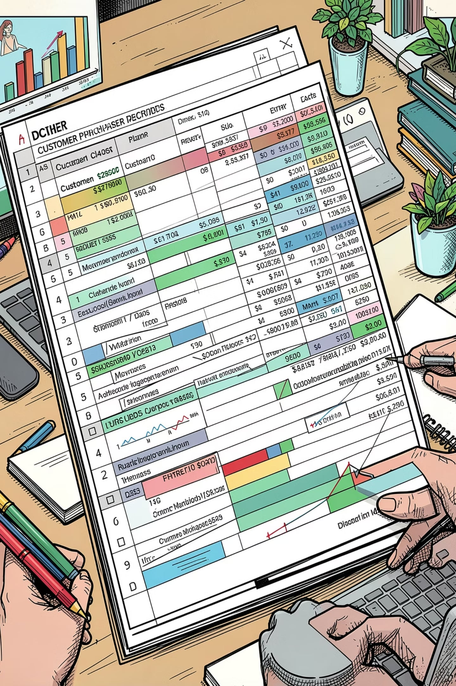
Dataset at a Glance
3,900
18
Purchases
Features
37
Missing Values
Review Rating only
Demographics · Purchase details · Shopping behavior · Subscription status

Slide 3

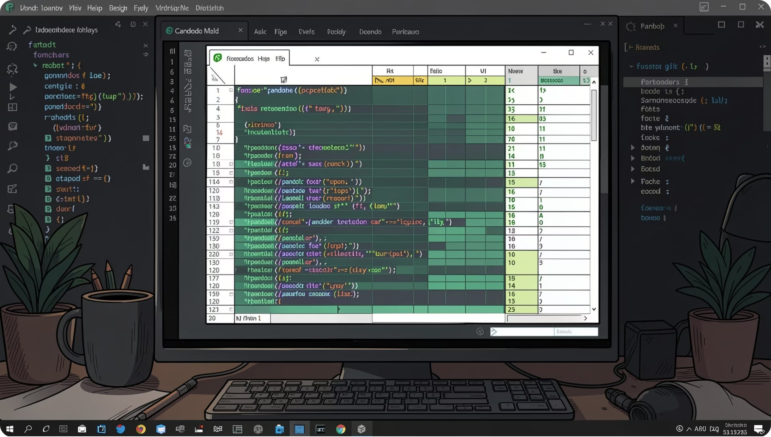



Data Preparation in Python
Load & Explore
Imported via pandas; df.info() & .describe()
Clean
Imputed missing Review Ratings by category median; snake_case columns
Engineer
Created age_group & purchase_frequency_days; dropped redundant promo_code_used
Integrate
Loaded cleaned DataFrame into PostgreSQL

Slide 4
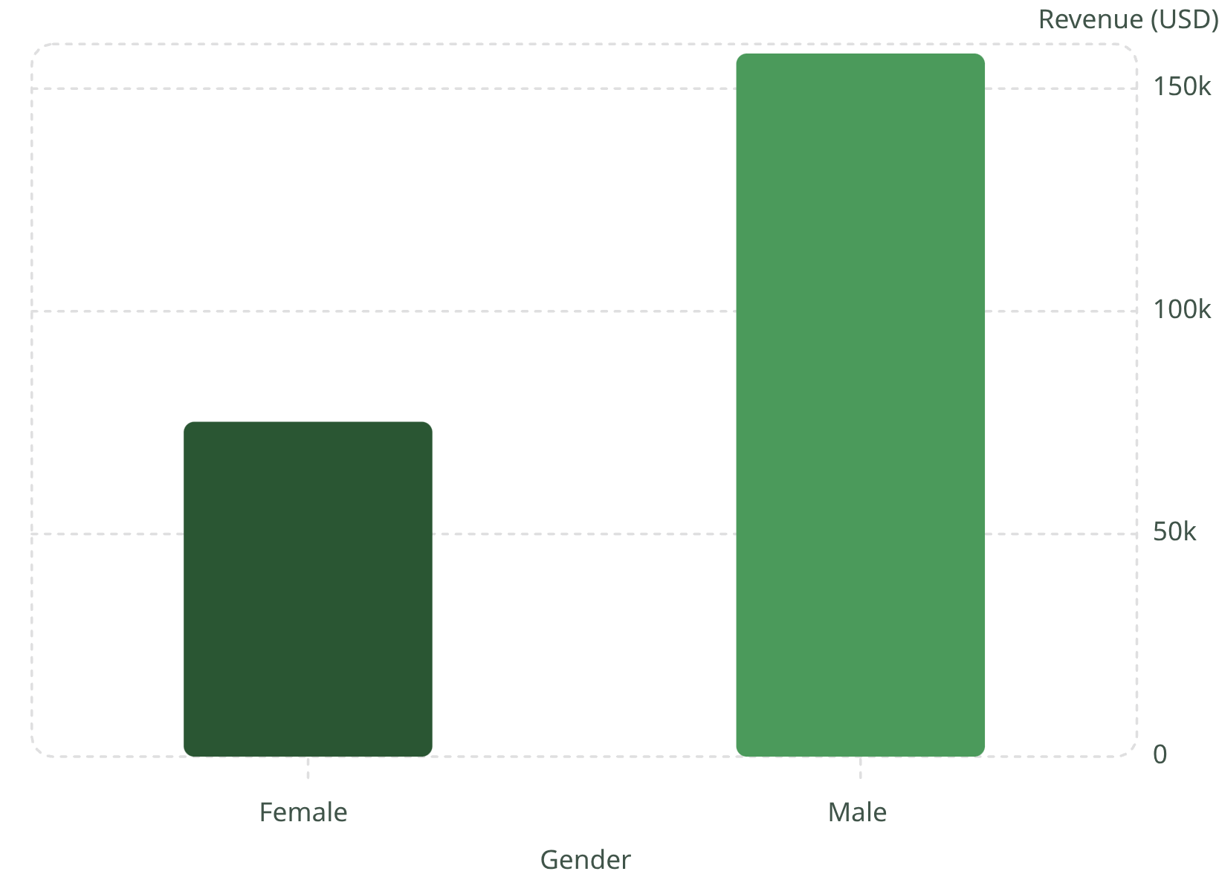

Revenue by Gender
Key Finding
Male customers generated 2.1× more revenue than female customers across 3,900 transactions.
Male: $157,890 · Female: $75,191

Slide 5
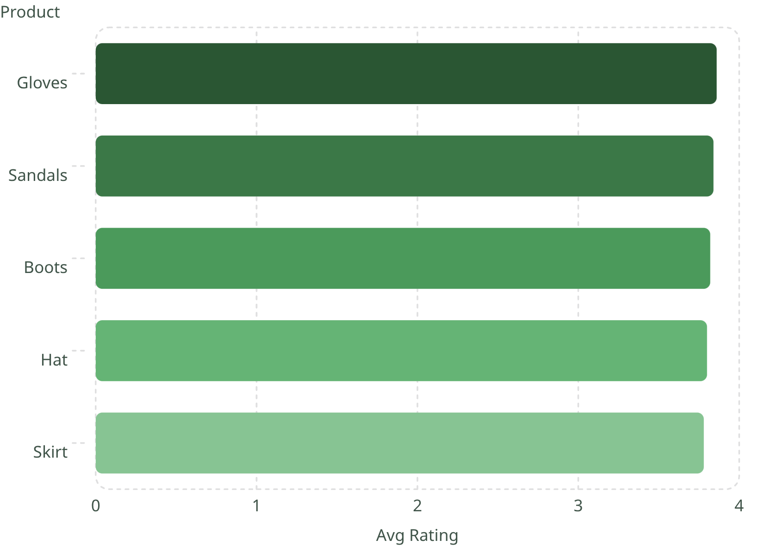
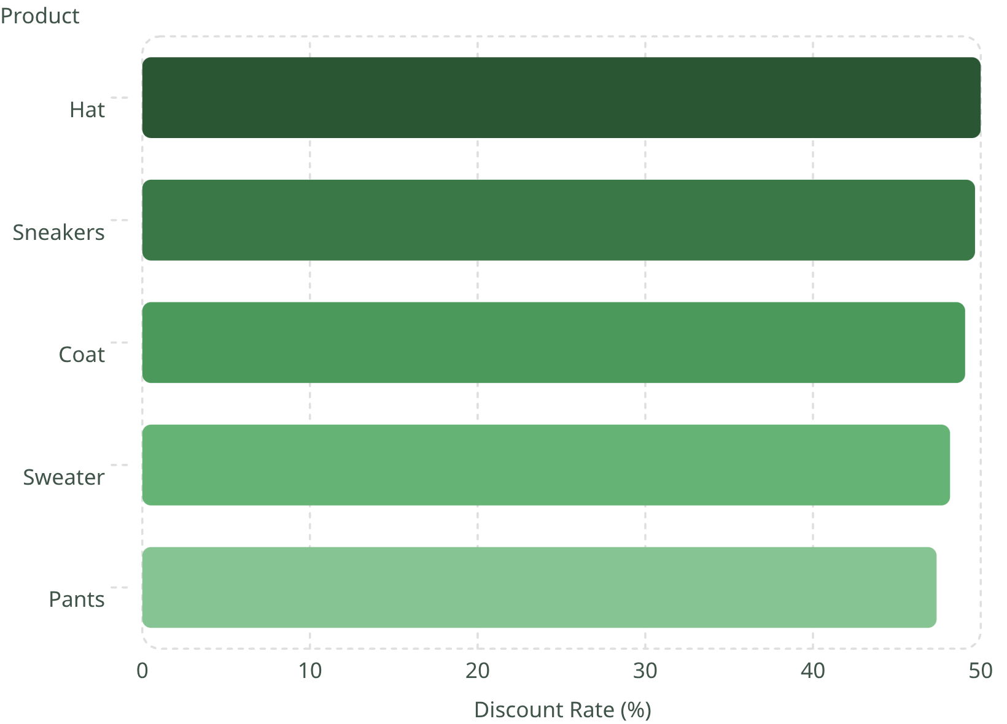
Product Insights
Top 5 Products by Rating
Most Discount-Dependent Products

Slide 6
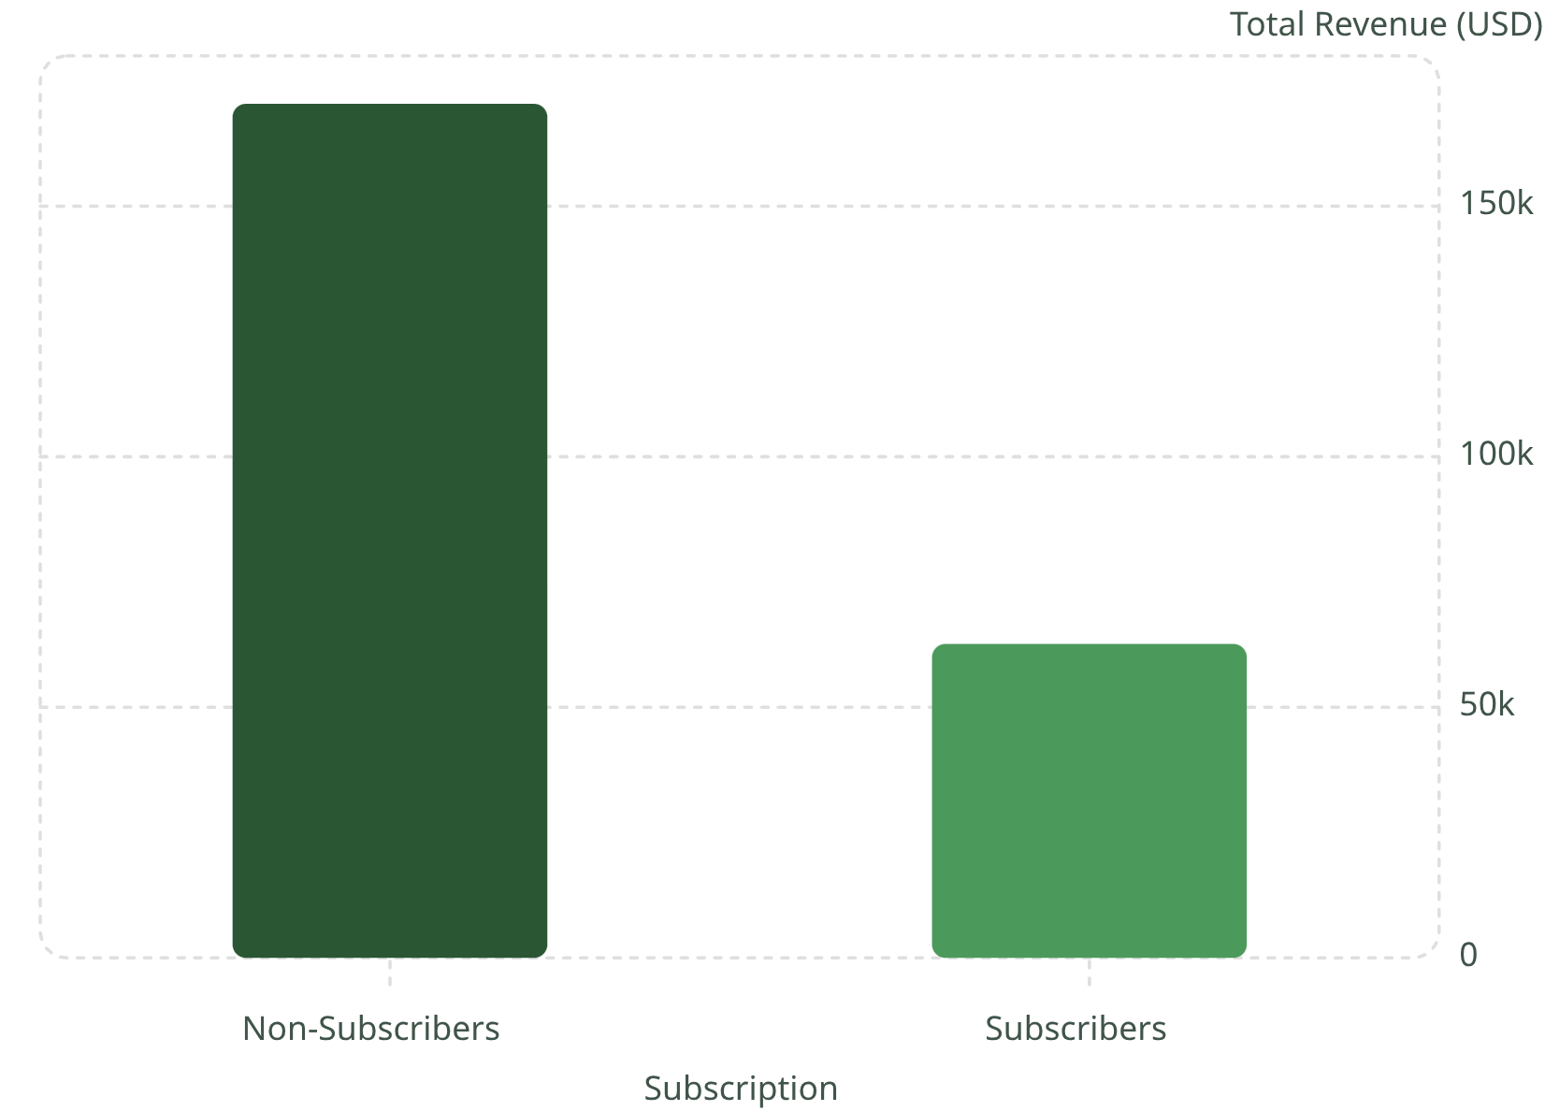
Subscription & Shipping Behavior
Subscribers vs. Non-Subscribers
Non-subscribers drive 73% of revenue despite near-identical avg spend (~$59).
Standard Shipping
Express Shipping
Avg $58.46
Avg $60.48

Slide 7
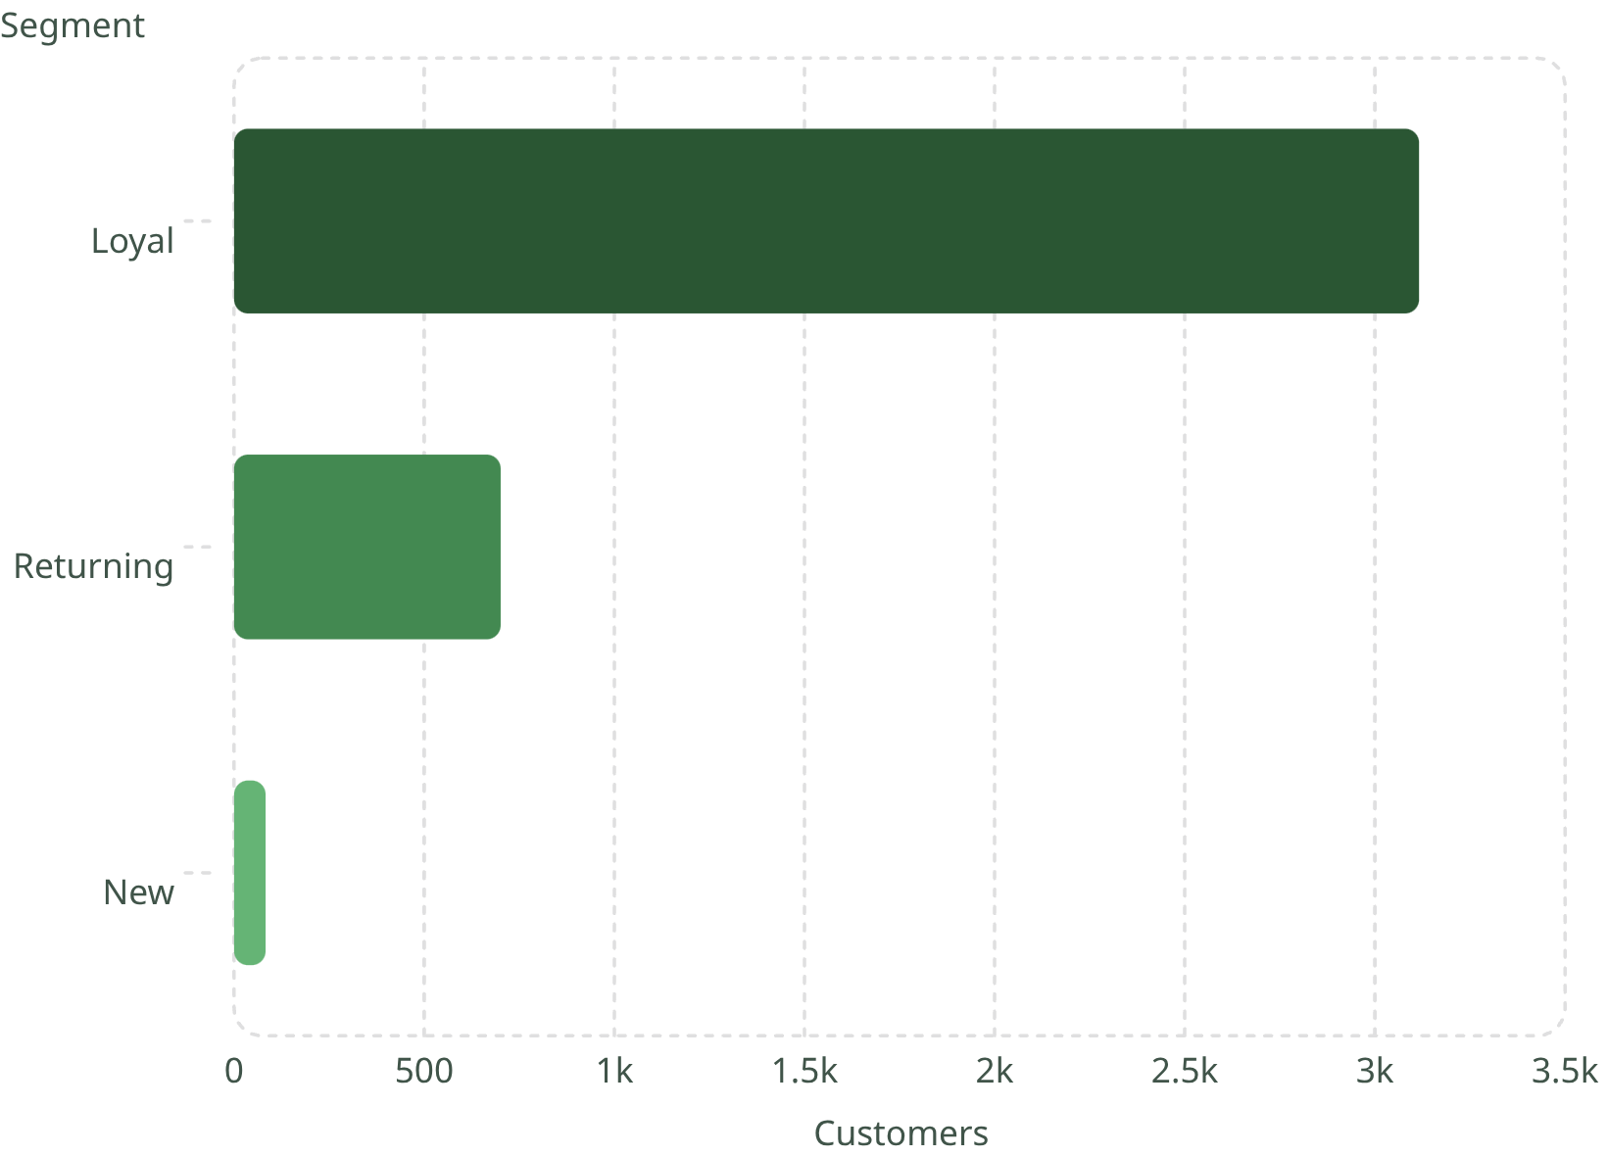
Customer Segmentation
Segment Breakdown
Based on purchase history — Loyal customers dominate at 80% of the base.
Loyal — 3,116
Returning — 701
New — 83
958 repeat buyers (>5 purchases) are subscribed vs. 2,518 non-subscribers

Slide 8
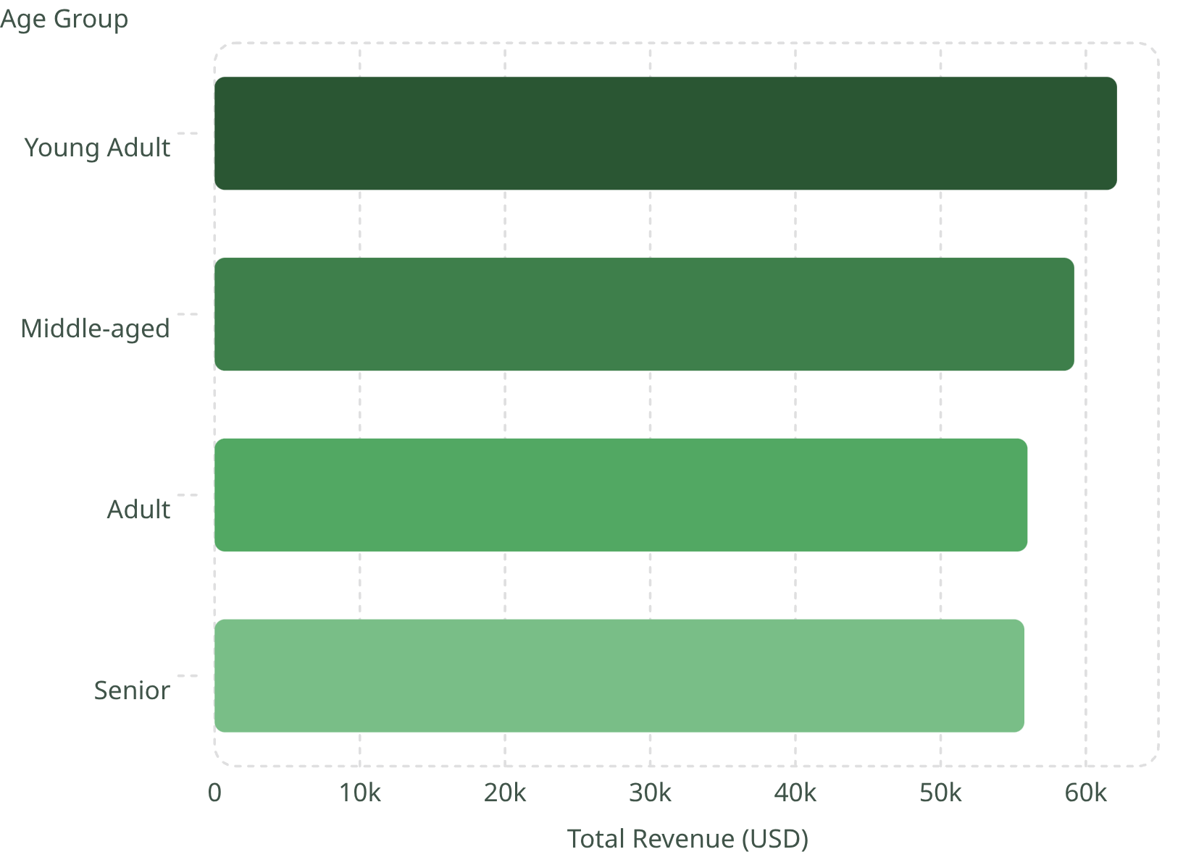

Revenue by Age Group
Age-Driven Revenue
Young Adults lead revenue, but all groups contribute relatively evenly — broad targeting opportunity.
Young Adult
Middle-aged
Adult
Senior
$62,143
$59,197
$55,978
$55,763

Slide 9

Power BI Dashboard
3.9K Customers
Total transactions tracked
$59.76 Avg Purchase
Mean spend per order
3.75 Avg Rating
Customer review score
27% Subscribers
Subscription penetration
Filters: Subscription · Gender · Category · Shipping Type

Slide 10





Business Recommendations
Boost Subscriptions
Loyalty Programs
Review Discount Policy
Promote exclusive subscriber benefits
Reward repeat buyers → Loyal segment
Balance sales lift with margin control
Targeted Marketing
Product Positioning
Focus on high-revenue age groups & express shippers
Highlight top-rated & best-selling products

